Slide 1
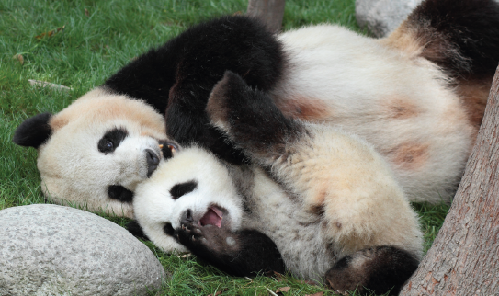
Conserving Panda Populations: Understanding Their Reproductive Endocrinology
Bio-Rad Explorer
Giant Panda Problem Kit for AP Biology

Slide 2
Curriculum & Training Specialists
Damon Tighe
Leigh Brown
Tamica Stubbs
bio-rad_explorer@bio-rad.com

Slide 3
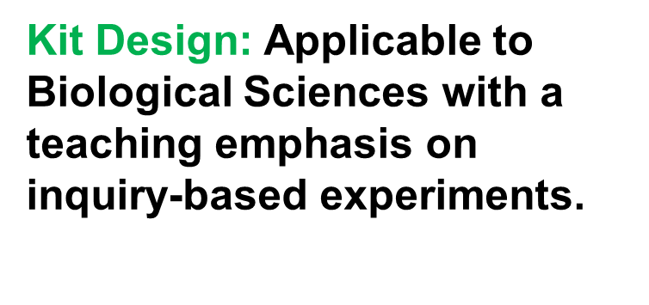
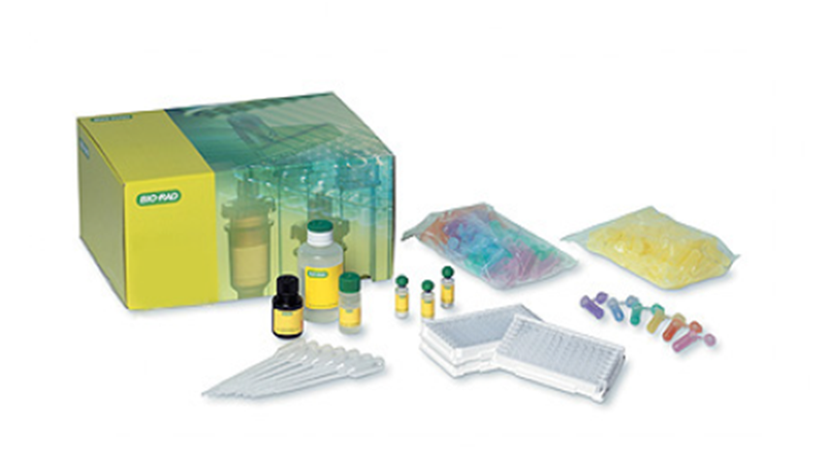
Giant Panda Problem Kit for AP Biology: A ThINQ! Investigation

Slide 4
Workshop Overview
Understand the ecological context that has negatively impacted Giant Panda Populations.
Learn how an Enzyme Linked Immunoassay (ELISA) detects the presence of particular antigens or antibodies.
Design an ELISA model that specifically detects a reproductive hormone.
Determine reproductive state of female Giant Pandas by analyzing hormone levels.

Slide 5
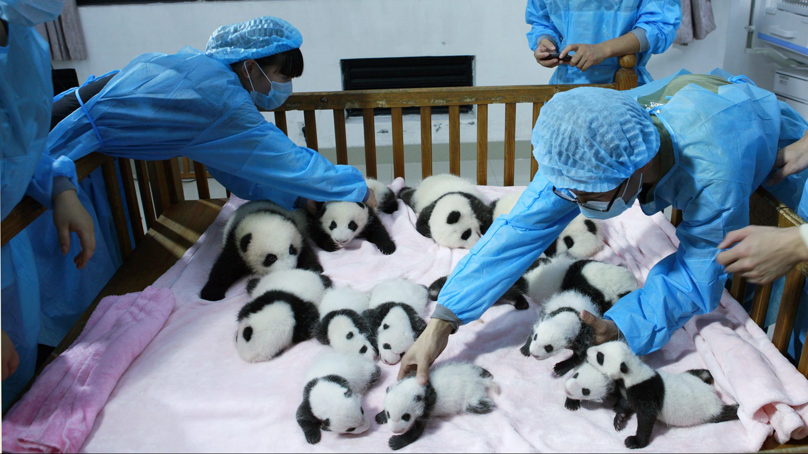
Setting the Stage for Learning: Making Observations & Drawing Inferences
https://qzprod.files.wordpress.com/2016/09/rtx13wbc-e1473184614668.jpg?quality=80&strip=all&w=3500
Notes:
Observe Image
What story do you think that this image tells? What sort of inferences would you draw regarding human interactions with giant pandas? What potential claims would you make regarding giant panda populations?

Slide 6
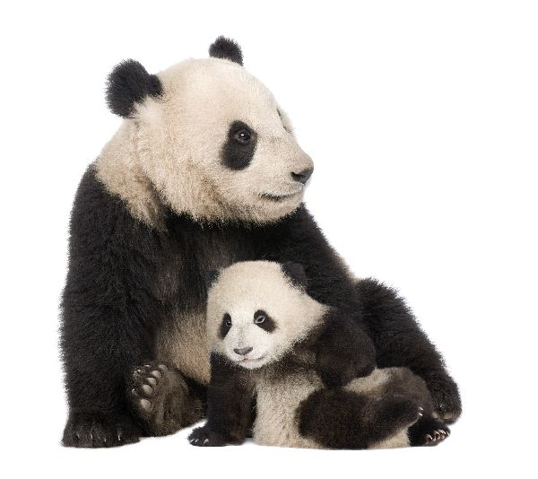
Giant Panda Background
Scientific Name: Ailuropoda melanoleuca
Geography: Mountains of Central China
Trophic level: Herbivorous
Ecological Niche: Umbrella Species
Lifespan: 20 years (In the wild)
Reproductive Rate: 1 young every 2 years in the wild. Twins more common in captivity.
Conservation status: Recently moved to Vulnerable status (September, 2016).
http://bioexpedition.com/wp-content/uploads/2012/05/Giant_Panda_and_Cub_-_Ailuropoda_Melanoleuca_600.jpg
Notes:
Scientific name means black and white cat foot.
Though classified as herbivorous, they don’t possess proper anatomical nor chemical machinery to efficiently digest bamboo. It is a plentiful resource that has made it a practical food option of choice. This leads to inefficient processing of nutrients and requires frequent feeds, (20-40 lbs of bamboo per day roughly 13% of their weight).
An Umbrella Species is a wide ranging species who’s habitat requirements reflect those of many in its ecological community.
A Keystone Species is a species that has a disproportionately large effect on its environment relative to its abundance. This species maintains the character of its ecosystem by keeping its prey in check to a point where it consequently minimizes the potential devastation of critical organisms in several trophic levels below it. It is analogous to the keystone in an arch. That is, it sustains the least amount of pressure in the structure, but the arch would collapse without it.

Slide 7
Revisit & Modify Initial Inferences
https://qzprod.files.wordpress.com/2016/09/rtx13wbc-e1473184614668.jpg?quality=80&strip=all&w=3500
Notes:
Based on some of the background information (previous slide), what story do you think that this image tells now? What sort of claims or inferences would you make, draw or revise regarding giant panda populations and human interactions? What facts drove the revision of your story, claims and/or inferences?
For example:
Initial Inference or Claim: Humans help to care for or raise Giant Panda’s young to minimize cub death rate.
Modified Inference or Claim: Humans bring Giant Pandas into captivity and help with raising their young to prevent them from entering or reentering an endangered species status.

Slide 8
The Giant Panda’s Population Plight!
Over the past 4 decades, giant panda populations have been negatively impacted due to several factors:
Habitat Disruption and Fragmentation
Climate Change
Poaching
Urban Sprawl
Interruption of Migration Routes
Narrow Reproductive Window

Slide 9
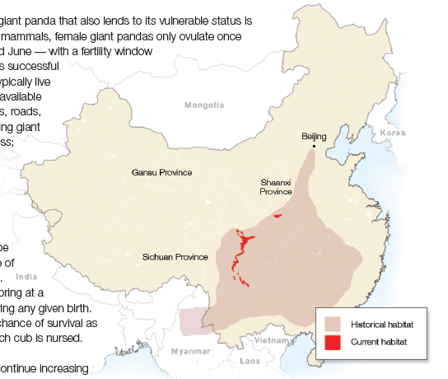
Habitat Loss
Notes:
Discuss how the reduction of habitat impacts availability of food, migration routes and ability to expand populations. Potentially discuss what the panda’s status as an umbrella or keystone species implies about the other losses that may be suffered by the ecological community that it thrives in.

Slide 10
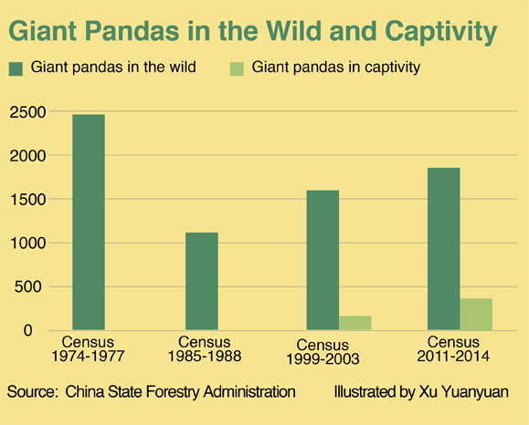
According to the graph, did the Giant Pandas experience a population bottleneck event?
Habitat Loss & Genetic Diversity
Increased deforestation efforts.
http://english.caixin.com/2016-09-28/100992943.html
Major bamboo die off event and increase in panda poaching.
Notes:
The level of genetic diversity of giant panda populations in the wild, and consequently census data is determined by DNA analysis of Panda Poo or Scant Studies.
What are the potential genetic and evolutionary consequences of habitat destruction and panda population decline?
Bottleneck event: A population bottleneck (or genetic bottleneck) is a sharp reduction in the size of a population due to environmental events (such as earthquakes, floods, fires, disease, or droughts) or human activities (such as genocide)
Deforestation (1960) – In response to great population growth, panda habitats were diminished by loggers and peasants.
Bamboo Die Off Event (1983)- One threat that pandas face is natural: sporadic bamboo die-offs which occur every 40 to 120 years. Sometimes, for reasons yet not well understood, bamboo shoots, flower, seed and then die en masse. This can occur within vast growing regions in one fell swoop.
Potential follow up questions:
What is the impact on the population’s growth and genetic diversity?
What might be the potential impact on to those organisms that have similar living requirements (under the panda’s umbrella) of the Giant Panda?
What is the consequential impact on the panda’s ecosystem? How can human intervention aid in restoring population numbers, genetic diversity and ecological harmony within these populations & their habitats?

Slide 11
A two pronged approach is required to continue increasing numbers of giant pandas: 1) In the wild: Protection of pandas and their habitat. 2) In captivity: develop and utilize molecular and behavioral techniques that enhances panda copulative interactions.
Human Intervention
Notes:
Prong 2- raise brief discussion about techniques including ELISA

Slide 12
Panda Reproduction in Captivity Successes: Reproductive technologies (endocrinology) have increased monitoring capabilities during the female panda’s ovulation cycle. Select behavioral techniques have increased mating activities between male and female pandas. Human assisted cub rearing has ensured the survival success of cubs. Panda populations have increased in captivity by 17% between 2003 and 2015.
Reproductive Successes & Challenges

Slide 13
Panda Reproduction in Captivity Challenges: Female giant pandas only ovulate once per year - typically between February and June. Fertility window of about 72 hours. Implantation of an embryo can take up to several months. Males generally live a solitary existence in the wild. Reproductive technology enhancements are still needed to monitor & advance reproductive states of female pandas.
Reproductive Successes & Challenges
Notes:
‘solitary’ existence point – (1) that they may not encounter a female that is ovulating, and (2) they may not know what to do with a female when they encounter one because they have not taken sex ed class.

Slide 14
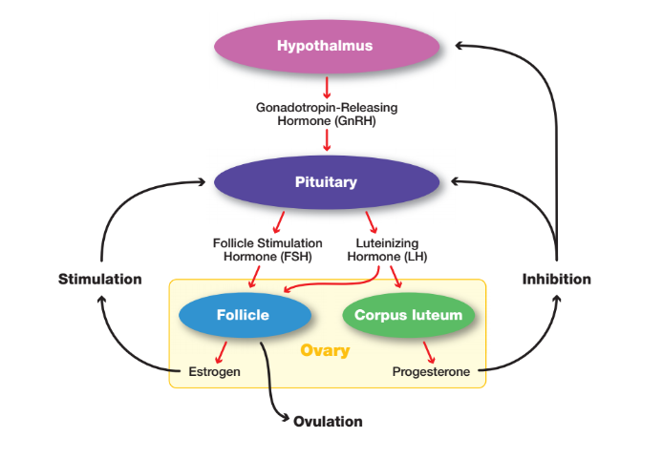
Molecular tests such as an ELISA can help us to monitor and visualize a variety of regulating agents in the body such as hormones that navigate the panda’s reproductive process.
Helpful Molecular Techniques
Notes:
Use graphic as an example to discuss homeostatic events in female pandas and to connect to existing techniques like ELISA that can, with improvements detect and visualize the presence and quantity of these chemical messengers. Draw out that these are endocrine system related events and point out that feedback mechanisms are critical in regulating and timing reproduction in animals and that detection is critical to predicting upcoming biological events.
Elaborate on the meaning of the names of the hormones, feedback systems, cellular communication, and anatomical relevance.
Address redundancy in the system.
The brain and ovaries are key anatomical players in the game of reproduction regulation. They produce hormones based on temporal cues (spring months for Pandas) and positive & negative feedback systems.

Slide 15
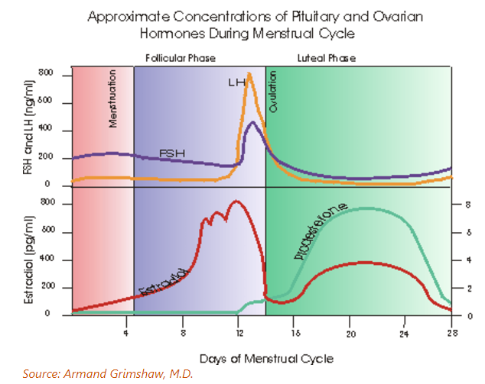
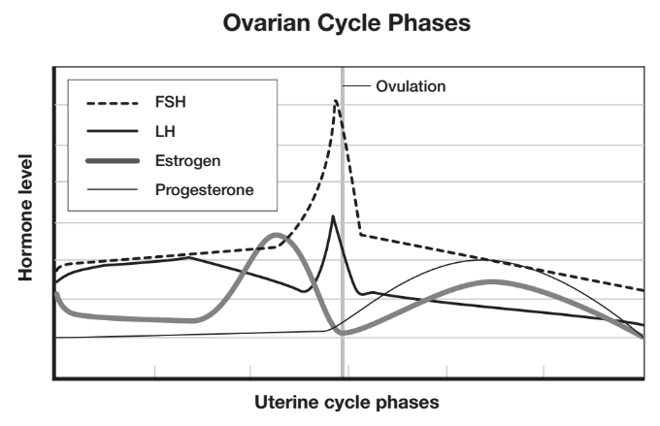
Enhancing Hormone Tracking
Based on the graph, which 3 hormones would be good predictors of ovulation in a female giant panda?
Which of the three reproductive hormones would provide the greatest accuracy for the onset of ovulation?
Progesterone (ng/ml)
weeks
Notes:
This could potentially be a think pair share activity.
If completing this activity in a 60 min session, it is not likely can’t that you can do the T/P/S. If 75-90 min, you would have time to do this.
If doing T/P/S could be nice to have this slide content as one of the handouts.
Estrogen levels need to be availed as a top contender to predict a pending ovulation event (which provides RE’s enough time to encourage mating events) and that we need to use a molecular technique like the ELISA to qualify and quantify these levels.
Could do T/P/S on the table content (positioned beneath the graph above), have audience discuss hypotheses, then show the graph and ask them to refine choices to just one hormone to test.

Slide 16
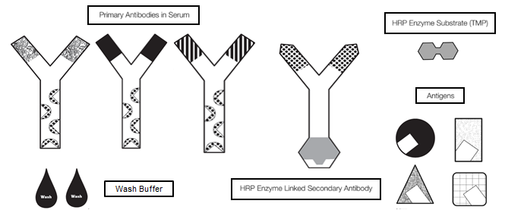
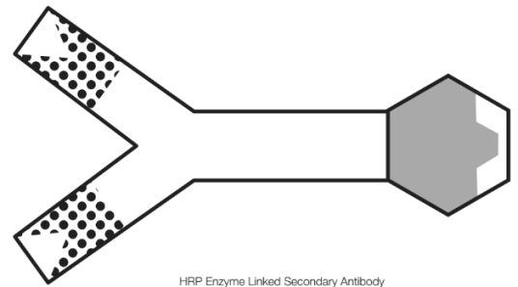
Enhancing Hormone Tracking
paper models to reflect hormone detection.
Notes:
Notes to come

Slide 17
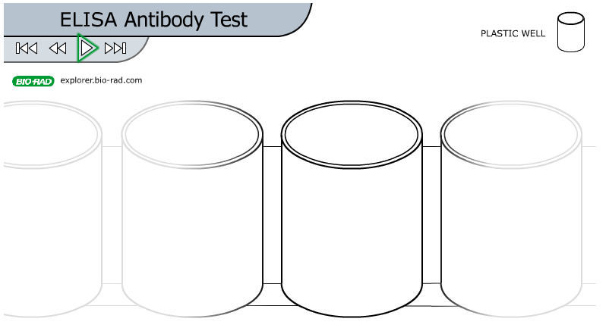
Enzyme Linked ImmunoSorbent Assay
ELISA Technique Explained
Notes:
Show hyperlinked video.
Point out that this can presented in class or a homework assignment for students to understand the technique or can be executed during day 1 of this investigation as outlined in the manual (Investigation #1)

Slide 18
Modeling to Protocol Building
Use the models to make a procedure. Molecules = 50ul, Washes = full wells.
Antigen?
2⁰ Antibody
1⁰ Antibody
Estrogen!
Substrate
Enzyme
50ul + 5min
50ul + 5 min
50ul + 5 min
50ul

Slide 19
Enhancing Hormone Tracking

Slide 20
Using your individual protocol designs and the corresponding reagents in the tubes at your lab stations, determine the ovulation status of the two following Giant Pandas: Panda 1 Panda 2
Testing Your Protocol Design!
http://www.factretriever.com/giant-panda-facts
Lin Lin (Age 7) Xi Xi (Age 8)
Notes:
In the kit, students test 4 panda samples. The sample pool was reduced to accommodate time constraints here.

Slide 21
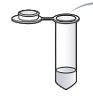
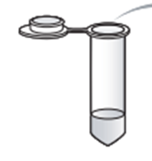
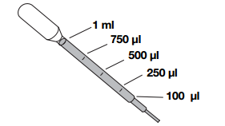
Applying your model based protocol
(Antigen)
Sample Fluids to be tested with your protocol
Materials from your model:
+ -
P1 P2 PA SA Sub
+ + - - P1 P1 P2 P2
Wash Buffer
Notes:
Review materials in front of audience
Fixed volume and tips

Slide 22
Modeling to Protocol Building
1⁰ Antibody
2⁰ Antibody
Sample
Substrate
Enzyme
50ul + 5min
50ul + 5 min
50ul + 5 min
50ul
+ + - - P1 P1 P2 P2

Slide 23
1st 5 minute wait….
Concept Corner
Your ID #
Your ID #

Slide 24
1st 5 minute wait….
Protein (Antigen)
Concept Corner
H
H
R
R
Hydrophobic
interactions
Polystyrene (plate)

Slide 25
2nd 5 minute wait…
Concept Corner
Your ID #
Your ID #

Slide 26
2nd 5 minute wait…
Variable region
Concept Corner
Heavy chain
Light chain
constant region
3,368,600 antibody combos

Slide 27
3rd 5 minute wait…
Concept Corner
Amplification of signal
Introduce HRP (Horseradish Peroxidase) for colormetric detection
Your ID #
Your ID #

Slide 28
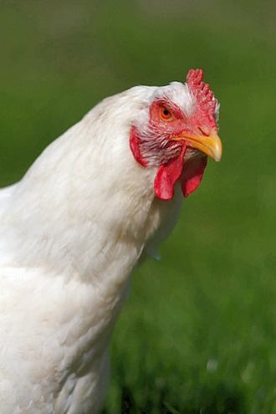
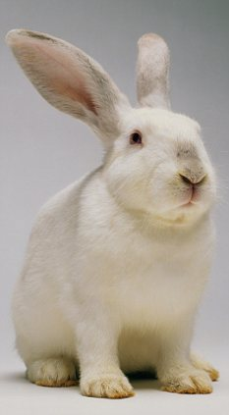
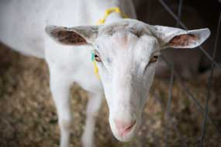
3rd 5 minute wait…
Concept Corner
Antigen = chicken gamma globulin
Primary Antibody = anti-chicken polyclonal antibody
Secondary Antibody = goat anti-rabbit conjugate to HRP
Notes:
The kit is using real antigens and real antibodies.
Chicken Gamma Globulin can easily be found in egg whites
To get a primary antibody most labs use to inject an animal like a rabbit with the antigen and then collect its plasma and filter out the anitibodies. Most contemporary antibodies are now made by hybridizing a cancer like cell with a plasma cell producing the antibodies so that you can continue to grow them in the lab without an animal.
Secondary antibody – could be made by injecting the constant domains of different animals antibodies and then taking the collected antibodies and covalently attaching an enzyme to them.

Slide 29
Testing Your Protocol Design
Share and discuss your results!
Notes:
Provide time for the audience to share out their models

Slide 30
Testing Your Protocol Design!
Considerations in your Protocol Execution:
Only load one layer of reagent to each well at a time.
Wash each tested well twice
fill each well completely for each wash before adding the next reagent.
Use DPTP for each wash.
Dispense only 50µl of each reagent using the fixed volume pipet.
Use a clean pipet tip for each reagent.
Allow for a 5 minute incubation period after reagents are loaded.
After each incubation period, empty all wells onto a clean paper towel surface before adding wash buffer.
Notes:
Change ul to micro
All washes will be done with dptp

Slide 31
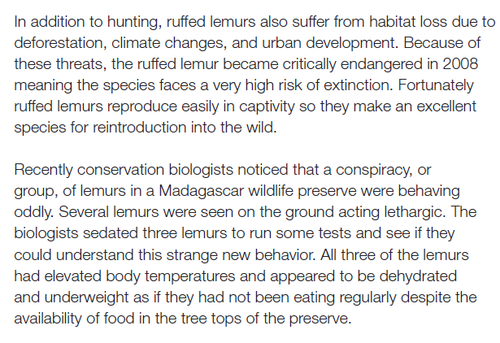
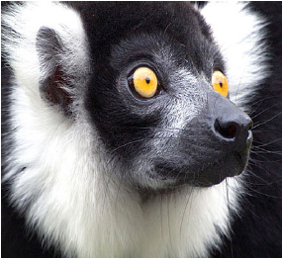
Extension Activity
Utilizing experiences to apply other conservation crisis: Ruffed Lemurs
Notes:
Note that this is a very good opportunity to develop an understanding of immunological responses in mammals. The science of immune responses could justifiably get a little more intense here.
Synopsis: Students read a case study about a conspiracy of lemurs in Madagascar who have been behaving oddly (lethargy), severely dehydrated and have elevated body temperatures. Three members of this critically endangered species are collected to determine if disease (agent) is the culprit of the lemurs behavior. Students use their understanding of ELISA tests to hypothesize about which ELISA type might be best to target a potential agent and analyze fictional test results of a rabies ELISA.
A video or mini lesson can be used to explain how a host of immune responses work in mammals to produce some of the symptoms (fever and lethargy) experienced by the lemurs as well as the potential biological products to test (eg. Antibodies or infectious agent) for their proposed ELISAs.

Slide 32
Extension Activity

Slide 33
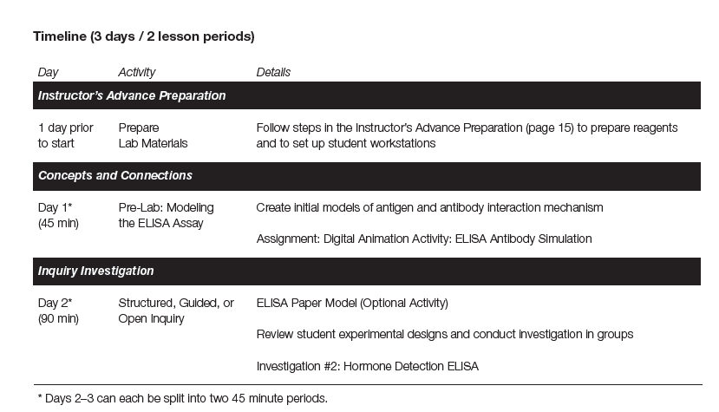
Lab Overview: Inquiry in a Time Crunch

Slide 34
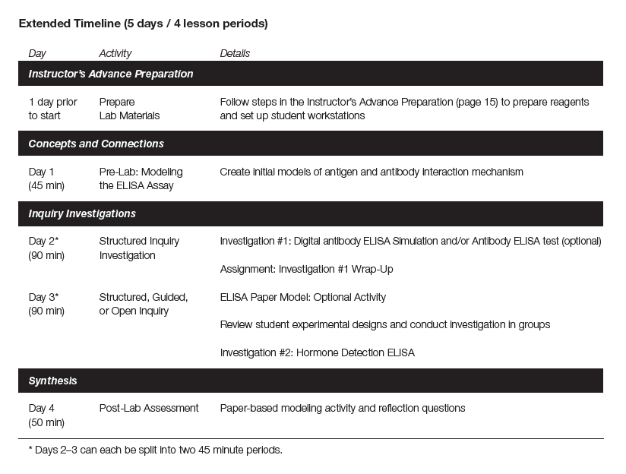
Lab Overview: Extended Inquiry

Slide 35
What are the benefits of inquiry?
Through inquiry, students:
Ask questions
Make predictions
Design plans to investigate answers to the questions
Apply mathematical routines to analyze data
Develop and refine testable explanations for observed phenomena
Ask new questions for further investigation

Slide 36
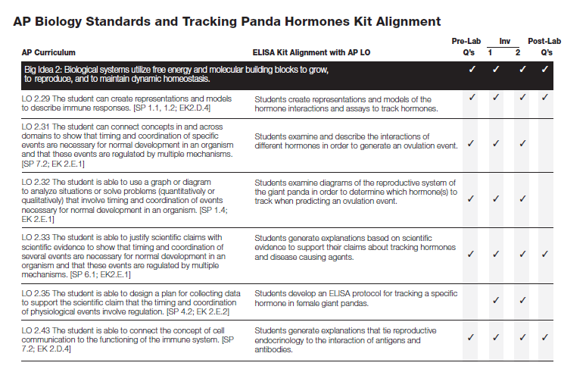
AP Standards: Big Idea 2!

Slide 37
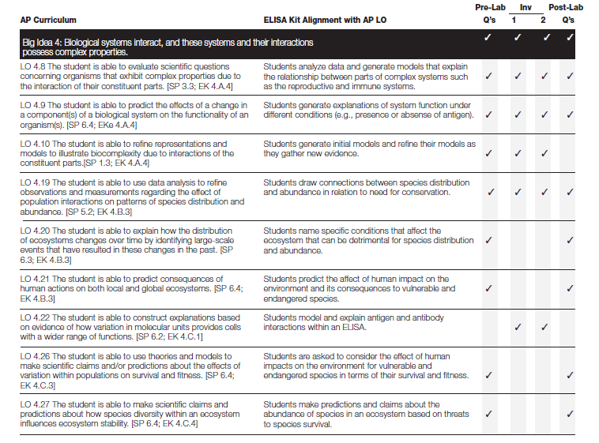
AP Standards: Big Idea 4!

Slide 38
ThINQ! Resource Page
bio-rad.com/ws/ThINQresources
Get teaching resources:
videos
case studies
class activities

Slide 39
Ordering information! 17002878EDU $138
Giant Panda Problem Kit for AP Biology

Slide 40
How to Buy

